Slide 1
AI/ML in the omics
Nikolaus Fortelny
Wolfgang Esser-Skala
January 2026

Slide 2


Why learn about AI / ML?
TODO - examples

Slide 3
Outline & Structure
Lecture: Introduction to basic ML and outlook to more complex AI algorithms.
Practical session (XX % o grade): Implementation of basic ML algorithms under guidance. Evaluation: upload your Jupyter notebooks.
Analyze a dataset of your choice (XX % o grade): Implement ML algorithm for unseen data yourself. Evaluation: upload your Jupyter notebook and present / discuss your results.
Journal club (XX % o grade): Discuss basic ML concepts in one journal article. Evaluation: Present an article.
Exam (XX % o grade): Basic concepts of AI/ML. Evaluation: Exam.

Slide 4
Schedule
Day 1 (today): ML basics / sklearn (lecture + practice)
Day 2: ML calculations / what is learning? pytorch (lecture + practice)
Day 3: Multi-class predictions (lecture + practice)
Day 4: Hyperparameters (lecture + practice)
Day 5: Random forest and interpretability (lecture + practice)
break of one week → work on final project
Day 6: Journal club presentations + work on final project
Day 7: Journal club presentations + work on final project
Day 8: Final project presentations + discussions
Day 9: Final project presentations + discussions
Day 10: Exam

Slide 5
(ideal) prerequesites
Bioinformatics practicals: Python programming
Module: Biomedical Data Analysis (MSc MedBio) R programming; statistics & data science in omics
Lecture: Big Data Management (MSc MolBio) ML & data science in omics; single-cell data

Slide 6
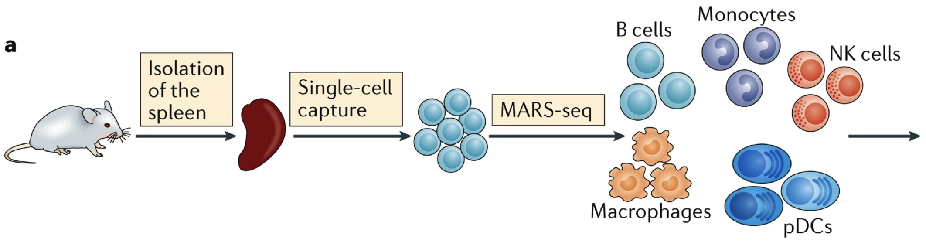
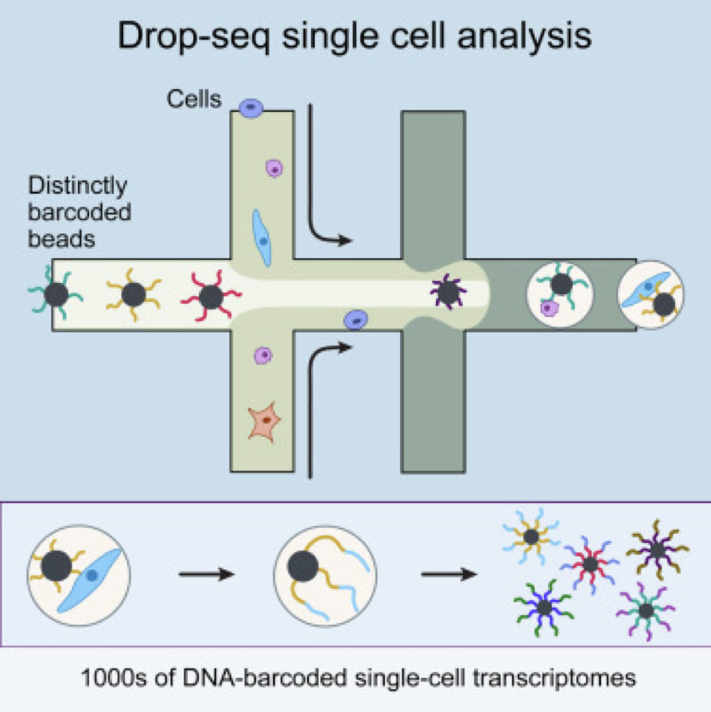
Single-cell RNA-seq as “omics” data
Wetlab (experimental)
Tissue
Single-cell suspension
Sequencing library
Drylab (computational)
Raw reads
Aligned reads
Data matrix
Clusters of cells
Assign cell types
Differential genes
https://doi.org/10.1186/s13073-017-0467-4
https://doi.org/10.1038/nri.2017.76

Slide 7
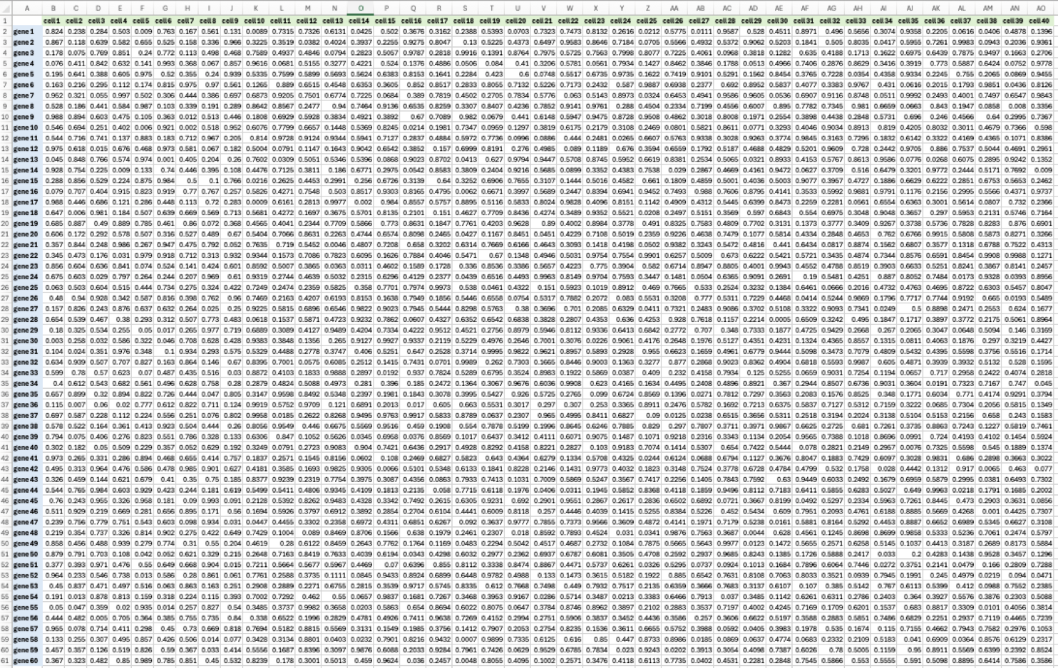
What do the resulting data look like?
Data
Metadata
Cell barcode | Sample
ATATGAC | Sample 1
TTAGAGT | Sample 1
TACCATT | Sample 2
CATTAGA | Sample 2
CCCATTA | Sample 3
… | …
Genes
Cells

Slide 8
Data structure
X: Data matrix
gene expression (values)
Obs: “observations” (meta data)
describes cells
sample, cell type, organ, treatment… for each cell
Var: “variables” (features):
describes genes
one row per variable
gene length, gene name, IDs from different databases,… for each gene
AnnData: https://doi.org/10.21105/joss.04371

Slide 9
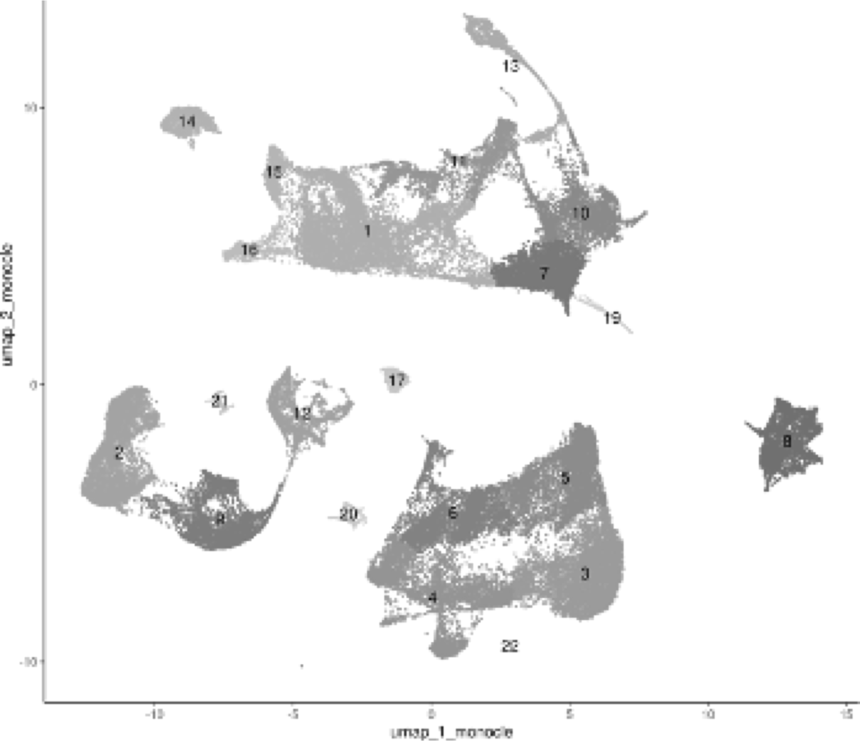
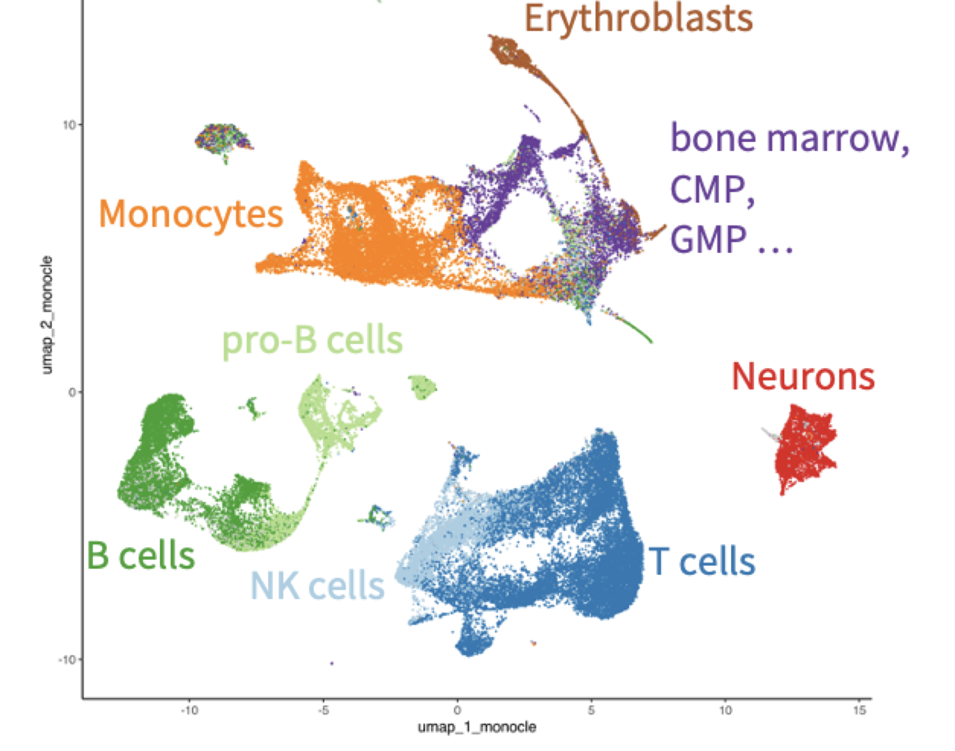
Our tasks: predict cell types
ML algorithm
This is what you will learn in this course!

Slide 10
Result after the prediction
Data
Metadata
Cell barcode | Sample | Cell type
ATATGAC | Sample 1 | B cell
TTAGAGT | Sample 1 | Neuron
TACCATT | Sample 2 | B cell
CATTAGA | Sample 2 | Monocyte
CCCATTA | Sample 3 | Neuron
… | … | …
Genes
Cells

Slide 11
How do we achieve this?
We have data where know the answer (another dataset).
We train an algorithm on this data. → train
We apply this model to data where we do not know the answer. → predict
We train an algorithm based on (additional) data where we know the correct cell type!

Slide 12
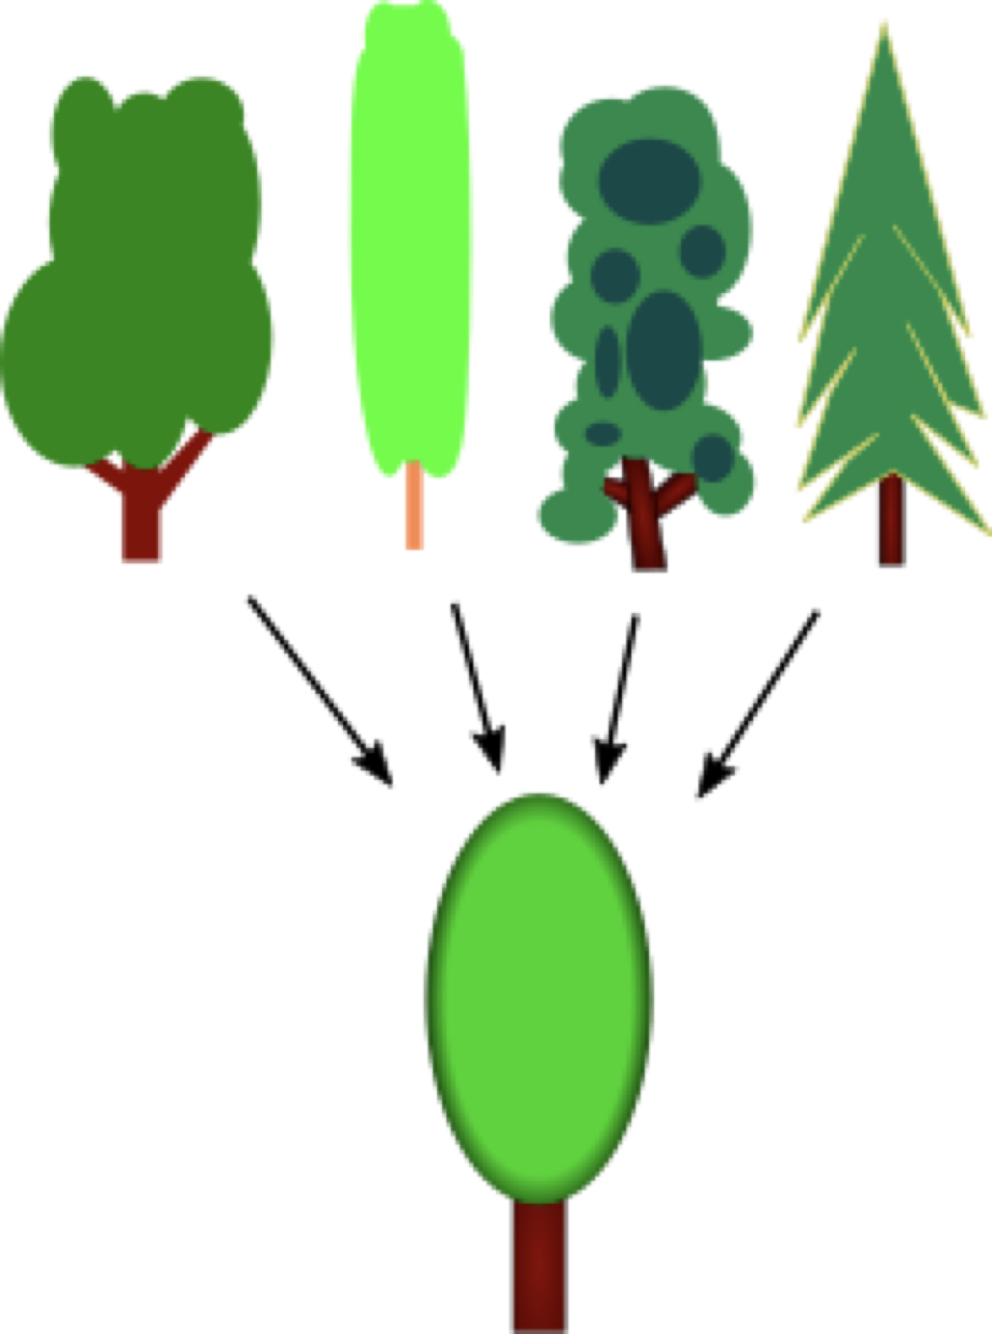
Train / test splits
We know the answer in our dataset!
We want to learn a function that will also predict on unseen data
Will our trained model generalize?
A generalised tree

Slide 13
Structure of ML problems
We have data where know the answer (cell type).
We train an algorithm on part of this data → train
We test on the remaining data (where we know the answer but the algorithm hasn’t seen it)! → test
We apply this model to data where we do not know the answer. → predict

Slide 14
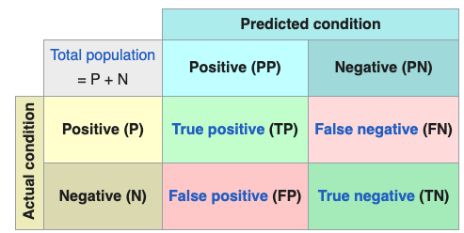
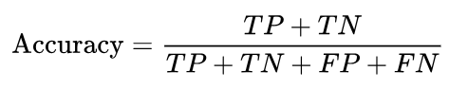
Performance evaluation 1: continguency tables and metrics
Needs true labels and predicted labels
Creates a continguency table
Various metrics:
Sensitivity / specificity
Precision / recall
…
We will use accuracy (easiest)
https://en.wikipedia.org/wiki/Evaluation_of_binary_classifiers

Slide 15
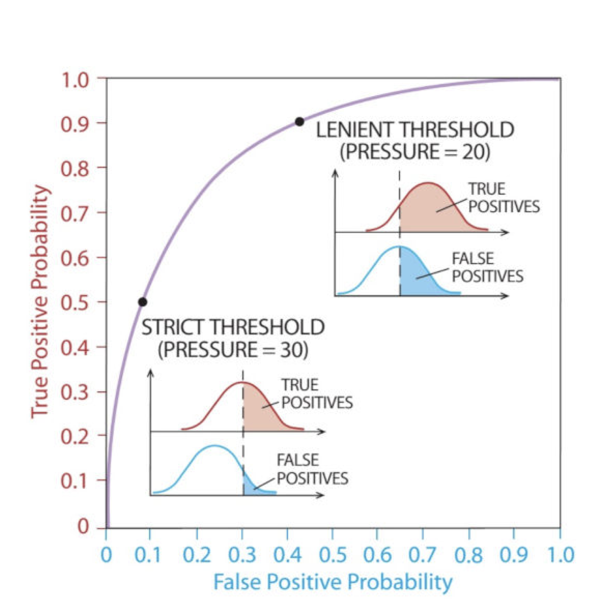
Performance evaluation 2: ROC AUC curves
ML predictions are usually class probabilities [0;1]
A cutoff (e.g. > 0.5) can be used to predict class 1 and class 0
ROC evaluates all cutoffs
At every step, we calculate
Sensitivity (true positive probability)
Specificity (false positive probability)

Slide 16
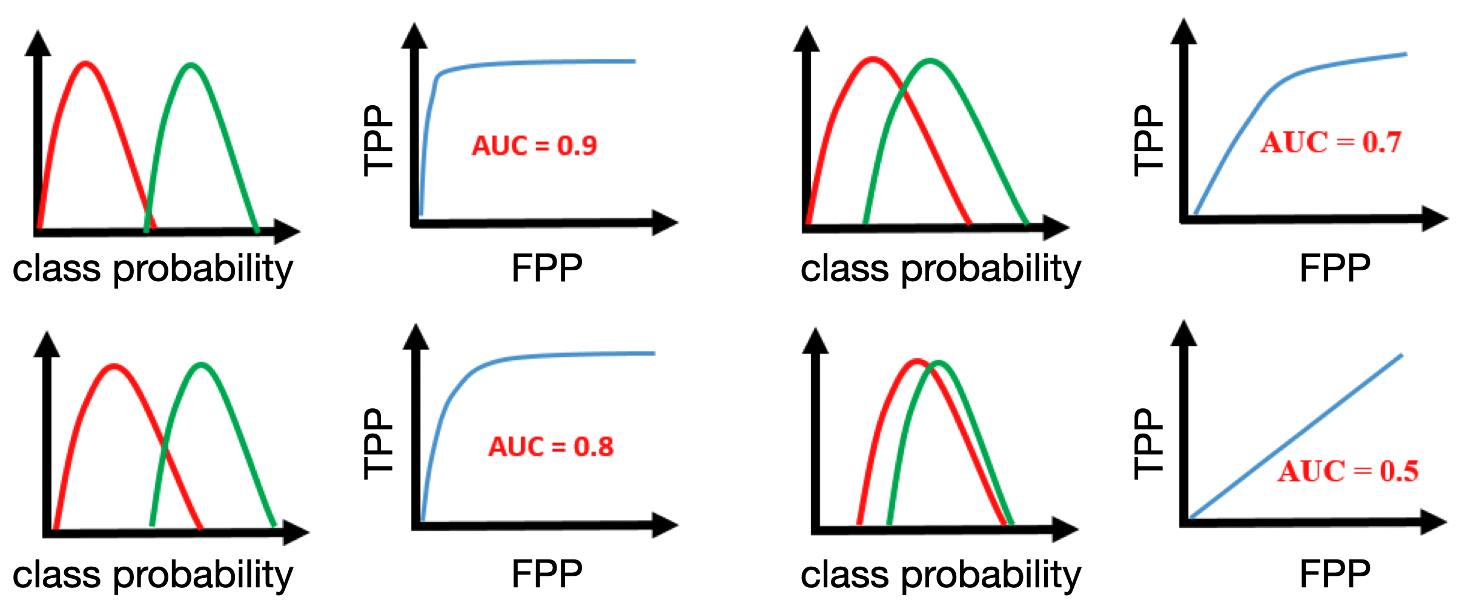
Performance evaluation 2: ROC AUC curves

Slide 17
Practical session 1
Install and load python packages
Download data (only bash step)
Load data (anndata)
Normalize (logCPM) and filter the data (lowly expressed genes)
Train ML model with sklearn
Evaluate performance
Train/test split
→ Explore the objects (type, dimensions, values)!

Slide 18
Python concepts: basics
Python works with indentation (and not {})
Functions are pre-defined (or imported from packages)
Basic data structures (lists/set and dictionary)
Objects have methods (~ functions) and attributes (~ variables)
obj.method1()
obj.method2()
obj.attribute1
obj.attribute2

Slide 19
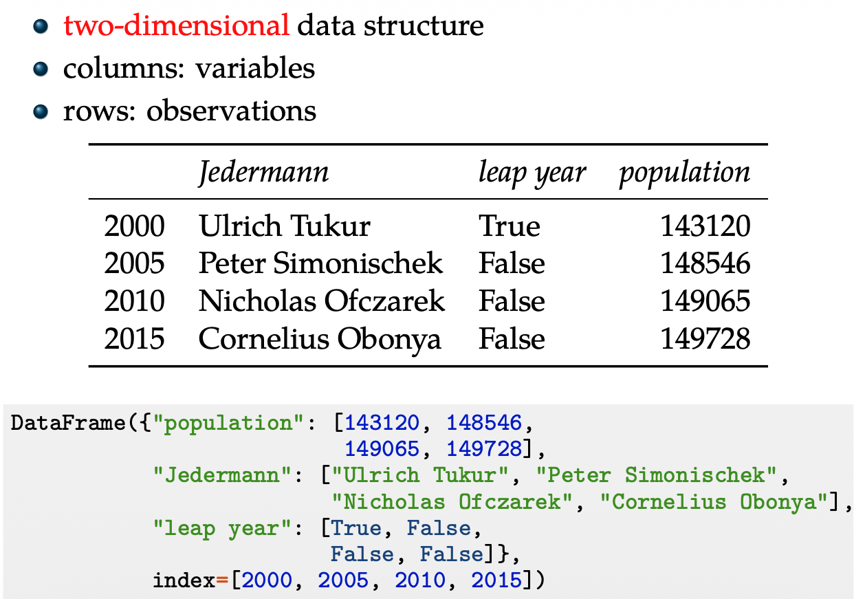
Python concepts: pandas DataFrame
Uses a dict to initialize the DataFrame
my_df.population will access the respective column (attribute)
my_df[“population”] also works
Columns are attributes of the DataFrame object

Slide 20
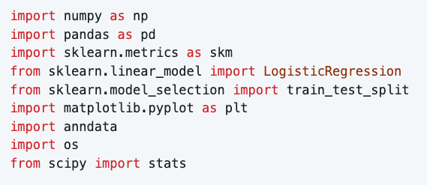
Practical session 1: Install packages
→ How do you call the functions?

Slide 21
Practical session 1: Download and load the data
wget -O data/my_dataset_small.h5ad https://datasets.cellxgene.cziscience.com/9d09a542-672b-4cc0-b4d4-05d318f5705f.h5ad
data = anndata.read_h5ad(…)
Note:
read_h5ad is a function from anndata
data.X, data.obs, and data.var are attributes of the object

Slide 22
Practical session 1: Normalize the data
You can modify data.X as follows:
data.X = …
For example:
data.X /= data.X.sum(axis=1)
calculates the sum of reads per cell and devide the data by this sum

Slide 23
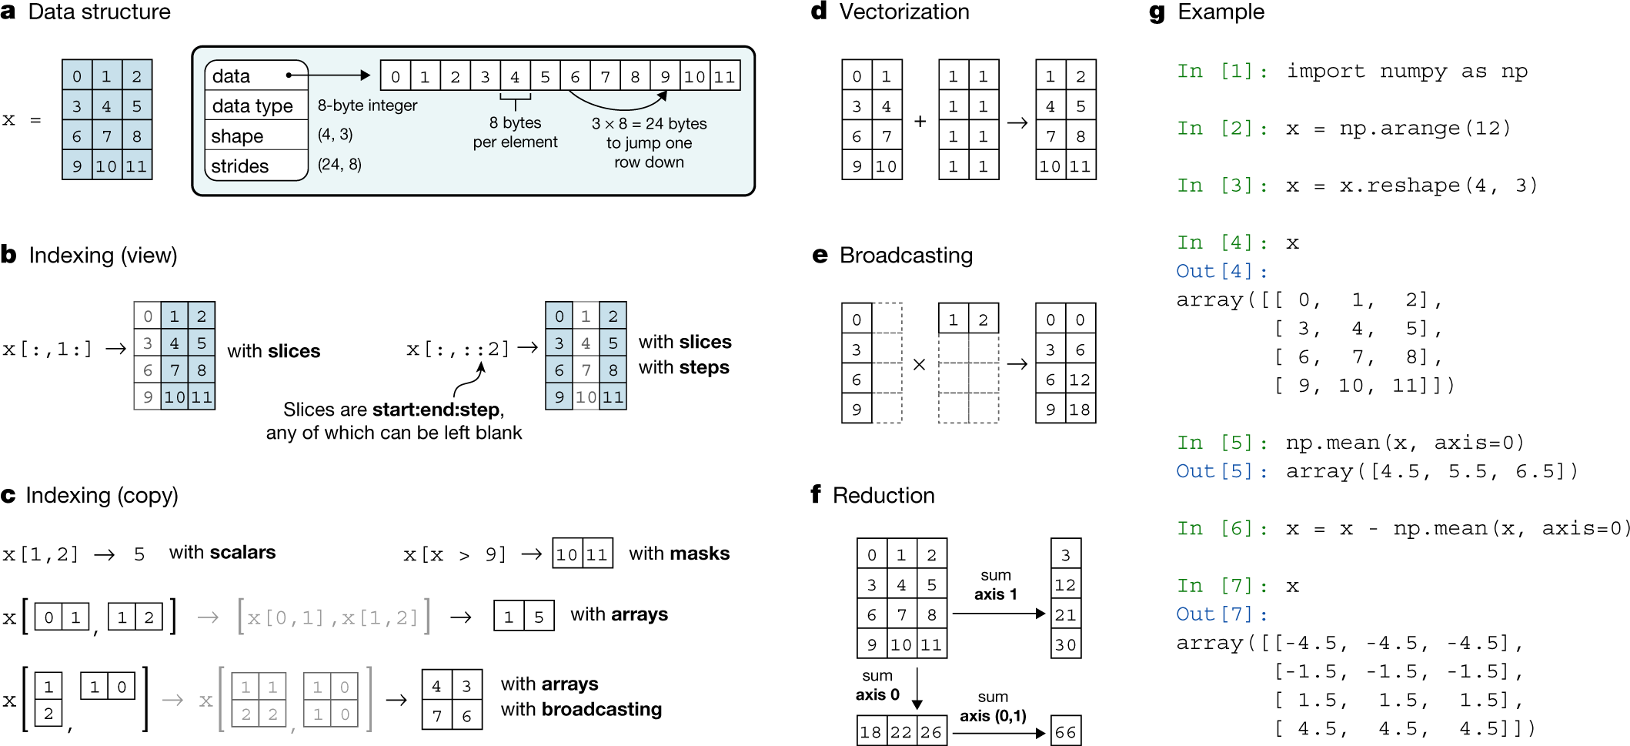
Practical session 1: Numpy

Slide 24
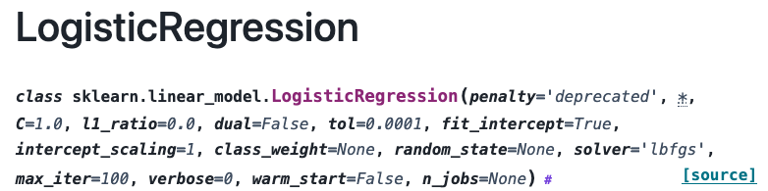
Practical session 1: Train ML model (1)
Define:
Input data X: normalized data.X
Output data Y: list of cell_type labels from data.obs
Model model: LogisticRegression(…)

Slide 25
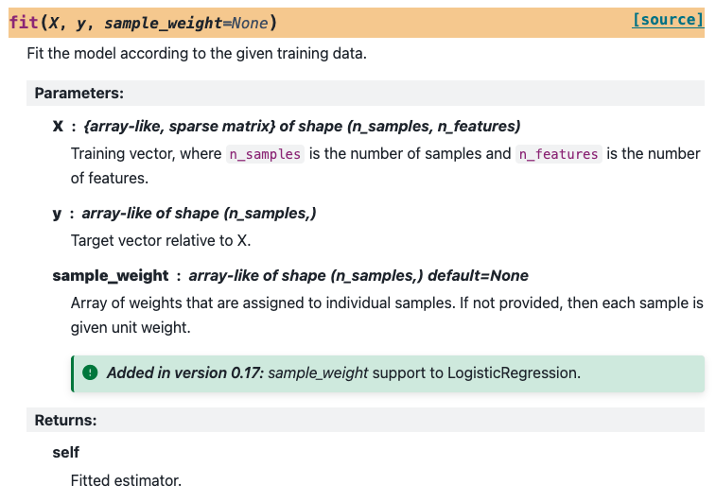
Practical session 1: Train ML model (2)
Fit the model to data using the method:
model.fit(…)

Slide 26
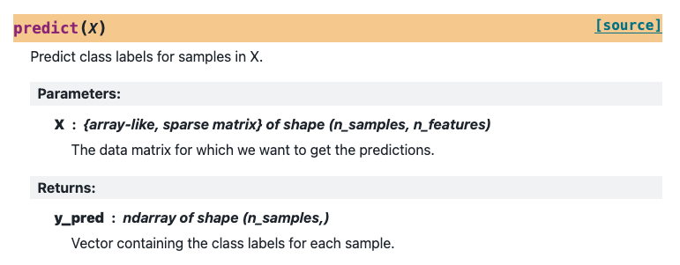
Practical session 1: Evaluate the model
Predict labels based on the trained model:
→ We will then compare the predicted labels with the true labels

Slide 27
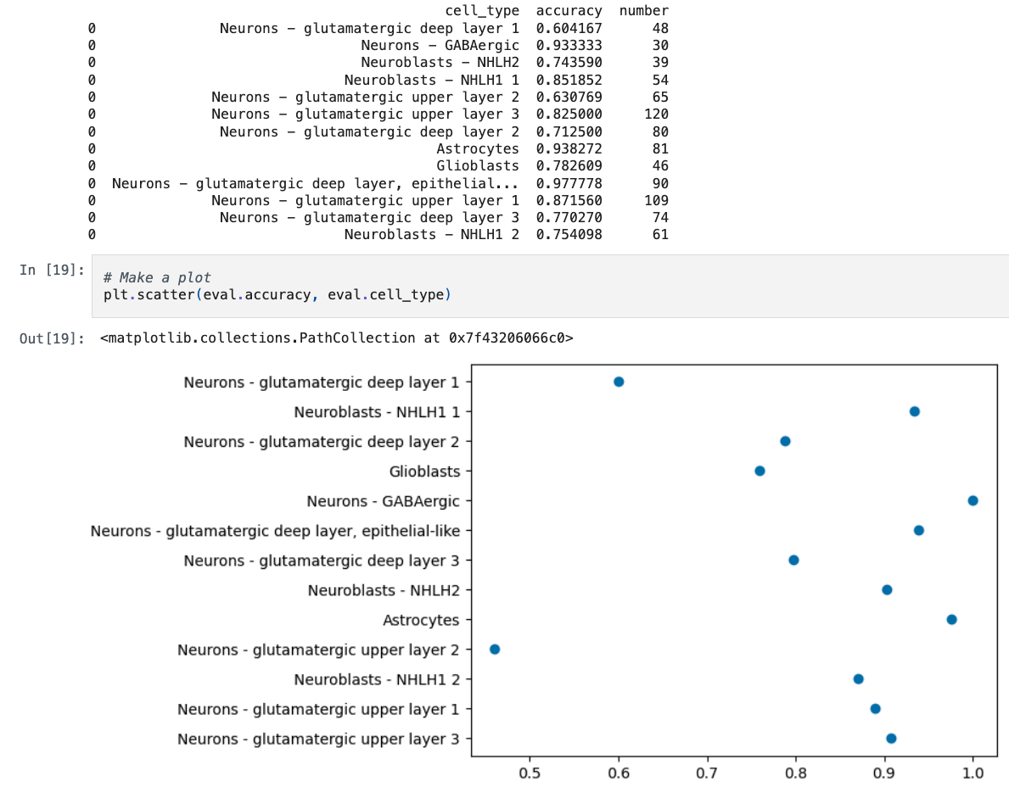
Plotting
We will make simple plots
matplotlib package
You can use any list-like element as x-axis and y-axis
Shown here for a pandas DataFrame

Slide 28
Practical session 1: Train / test split
X_train, X_test, Y_train, Y_test = train_test_split(X, Y, test_size=0.3)
Notes:
Use X_train and Y_train for training
Use X_test and Y_test only after training is completed

Slide 29
Session 2: ML calculations

Slide 30
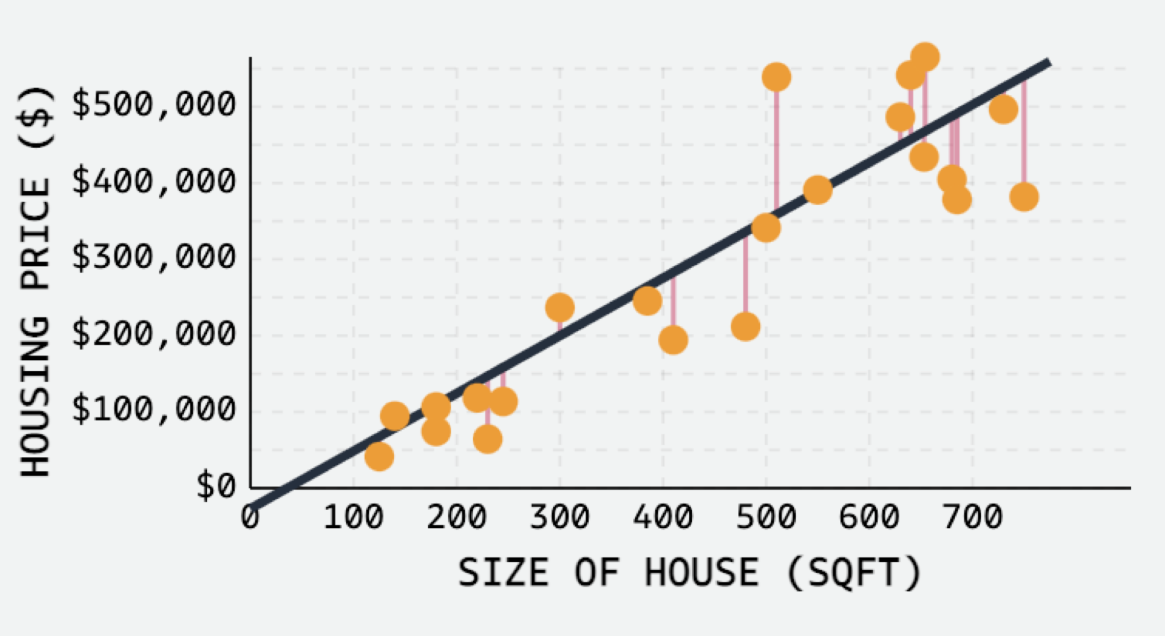
What is a model?
A formula to map input to output!
y = a + b * x
y = w₀ + w₁ * x
y … housing price
x … size of the house
a / w₀ … intercept
b / w₁ … slope
E.g. predict cell size from the expression of one gene

Slide 31
ML vocabulary
Vocabulary: Statistics - Machine learning
Response, predictant (y) output ← we know this
Covariates, predictor, features (x) input ← we know this
Parameters, coefficients (w) weights ← we want this!
Two main types
Classification: Predicting classes (cell types, …)
Regression: Predicting a number (time, red blood cell count, …)

Slide 32
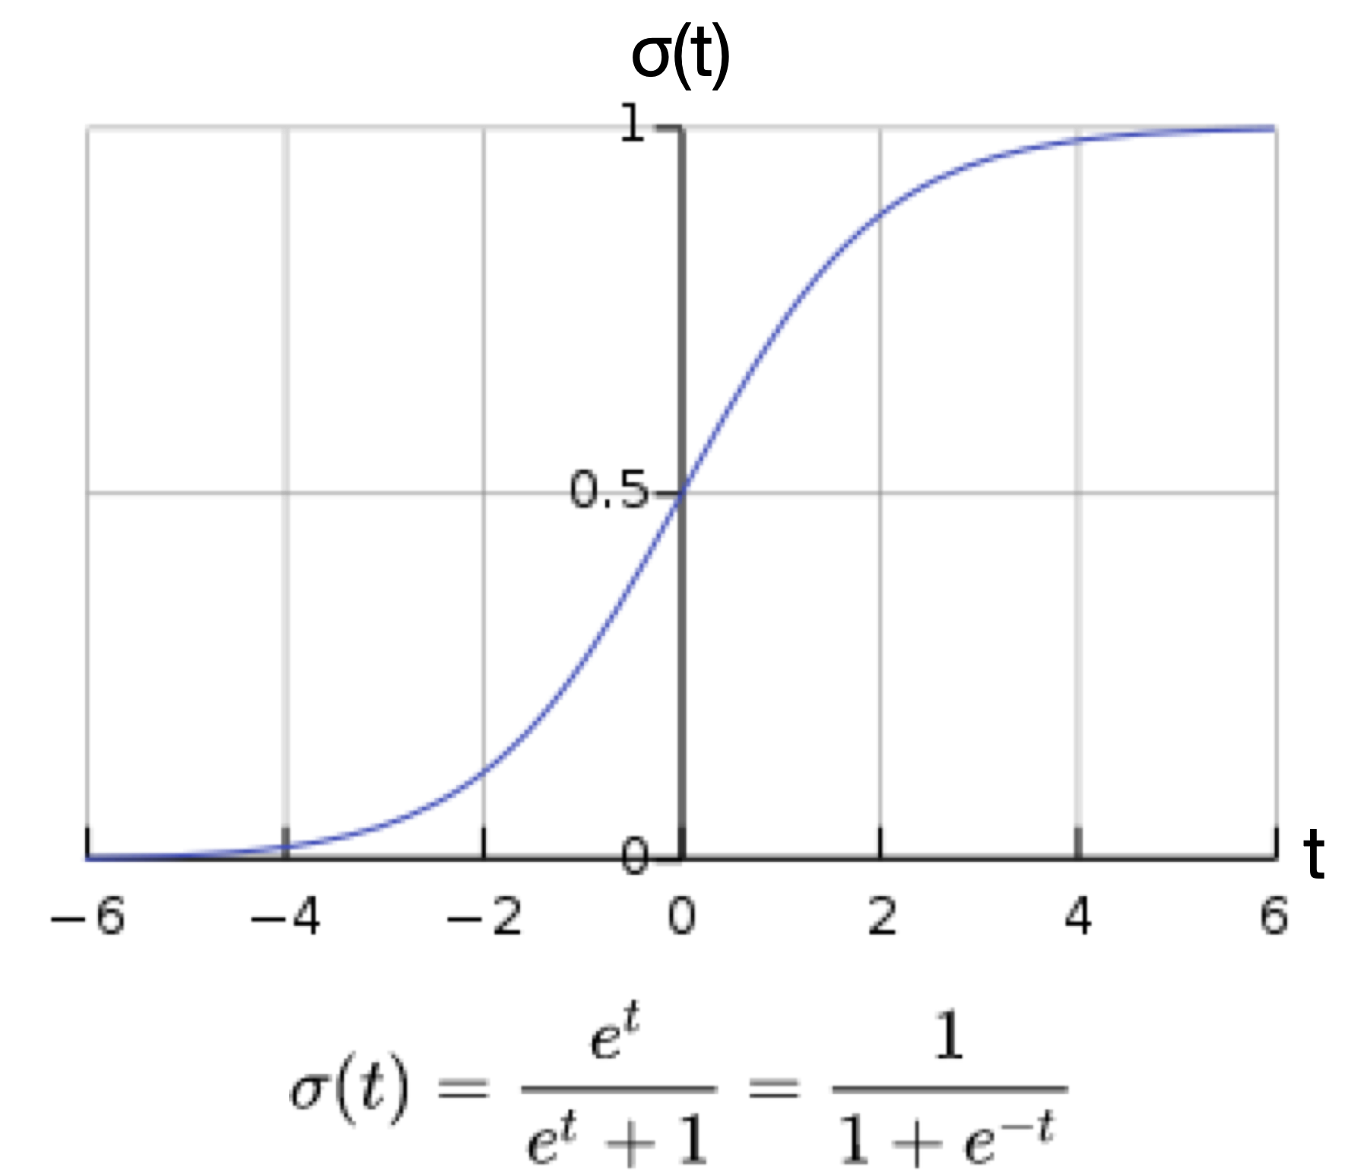
Classification instead of regression
We have a classification task:
Cell type 1 → class 0
Cell type 2 → class 1
Classification requires a sigmoid function:
y = σ(w₀ + w₁*x₁)
y is bound between 0 and 1 → probability of class 1
E.g. predict cell type from the expression of one gene (x₁)

Slide 33
What does this weight mean?
y = σ( w₀ + w₁ * x₁ )
w₁ = 0 → not relevant
w₁ < 0 → class 0
w₁ > 0 → class 1
Large value → larger effect
Negative values push towards class 0
Positive values push towards class 1

Slide 34
How does this calculation like in our example?
Input (x): 20,000 expression values
Output (y): cell type 1 or cell type 2
Weights (β/w): which genes are important?
Different ways of writing the same:
y = σ( w₀ * x₀ + w₁ * x₁ + w₂ * x₂ + … + w_{20,000} * x_{20,000} )
y … [1;0] cell type 1 or cell type 2
x_{i} … expression of gene I
x0 … is always 1 (intercept)
σ()… sigmoid function

Slide 35
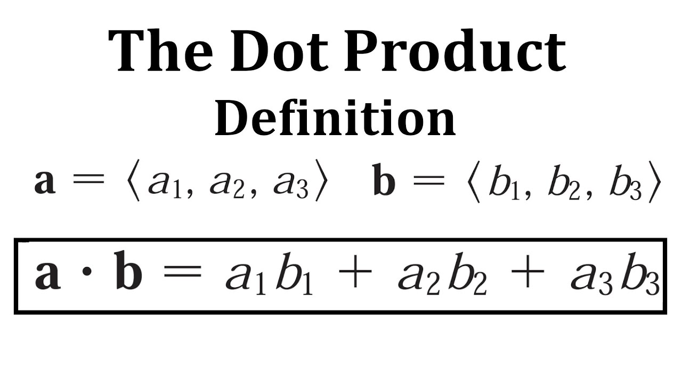
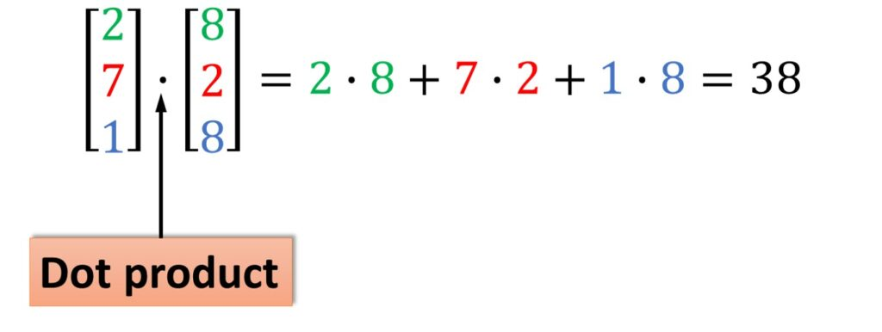
Calculation is done in a dot product
y = σ( w₀ * x₀ + w₁ * x₁ + w₂ * x₂ + … + w_{20,000} * x_{20,000} )
Y = σ( W . X )

Slide 36
Y = σ( W . X )
This is the logistic regression model we used in practical session 1!

Slide 37
What do the weights mean?
y = σ( w₀ * x₀ + w₁ * x₁ + w₂ * x₂ + … + w_{20,000} * x_{20,000} )
w_{i} = 0 → not relevant
w_{i} < 0 → class 0
w_{i} > 0 → class 1
Large value → larger effect
Negative values push towards class 0
Positive values push towards class 1

Slide 38
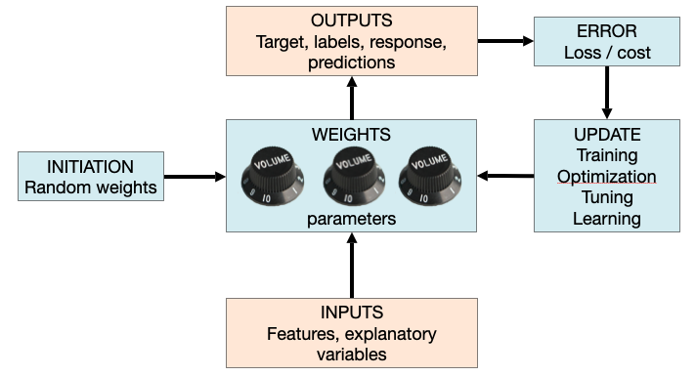
Now how do we learn?
Details on the update tomorrow!

Slide 39
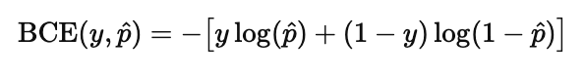
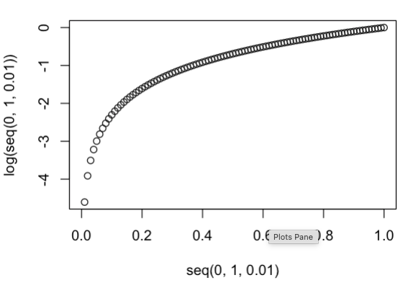
Loss function
Large loss if p_hat close to 0
Large loss if p_hat close to 1
y … true label [0;1]
p_hat … predicted label [0-1]

Slide 40
Key steps
Input (X): cells (observations) x genes (features)
Linear layer (X . W): input features → logits
Sigmoid transformation σ(): logits → class probabilities
Loss calculation: class probabilities + true class labels → error

Slide 41
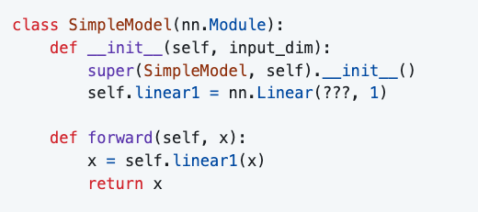
Practical session 2: pytorch implementation
model = SimpleModel(input_dim=???)
criterion = nn.BCELoss()
optimizer = optim.Adam(model.parameters())
outputs = model(X)
loss = criterion(???, ???)
model.train() # tell pytorch that we will train
optimizer.zero_grad() # remove previous gradients
loss.backward() # Do one backwards pass to calculate gradients
optimizer.step() # Optimize weights
Details tomorrow!
You only define the model (forward pass)​. Pytorch then optimizes weights (backward pass).

Slide 42
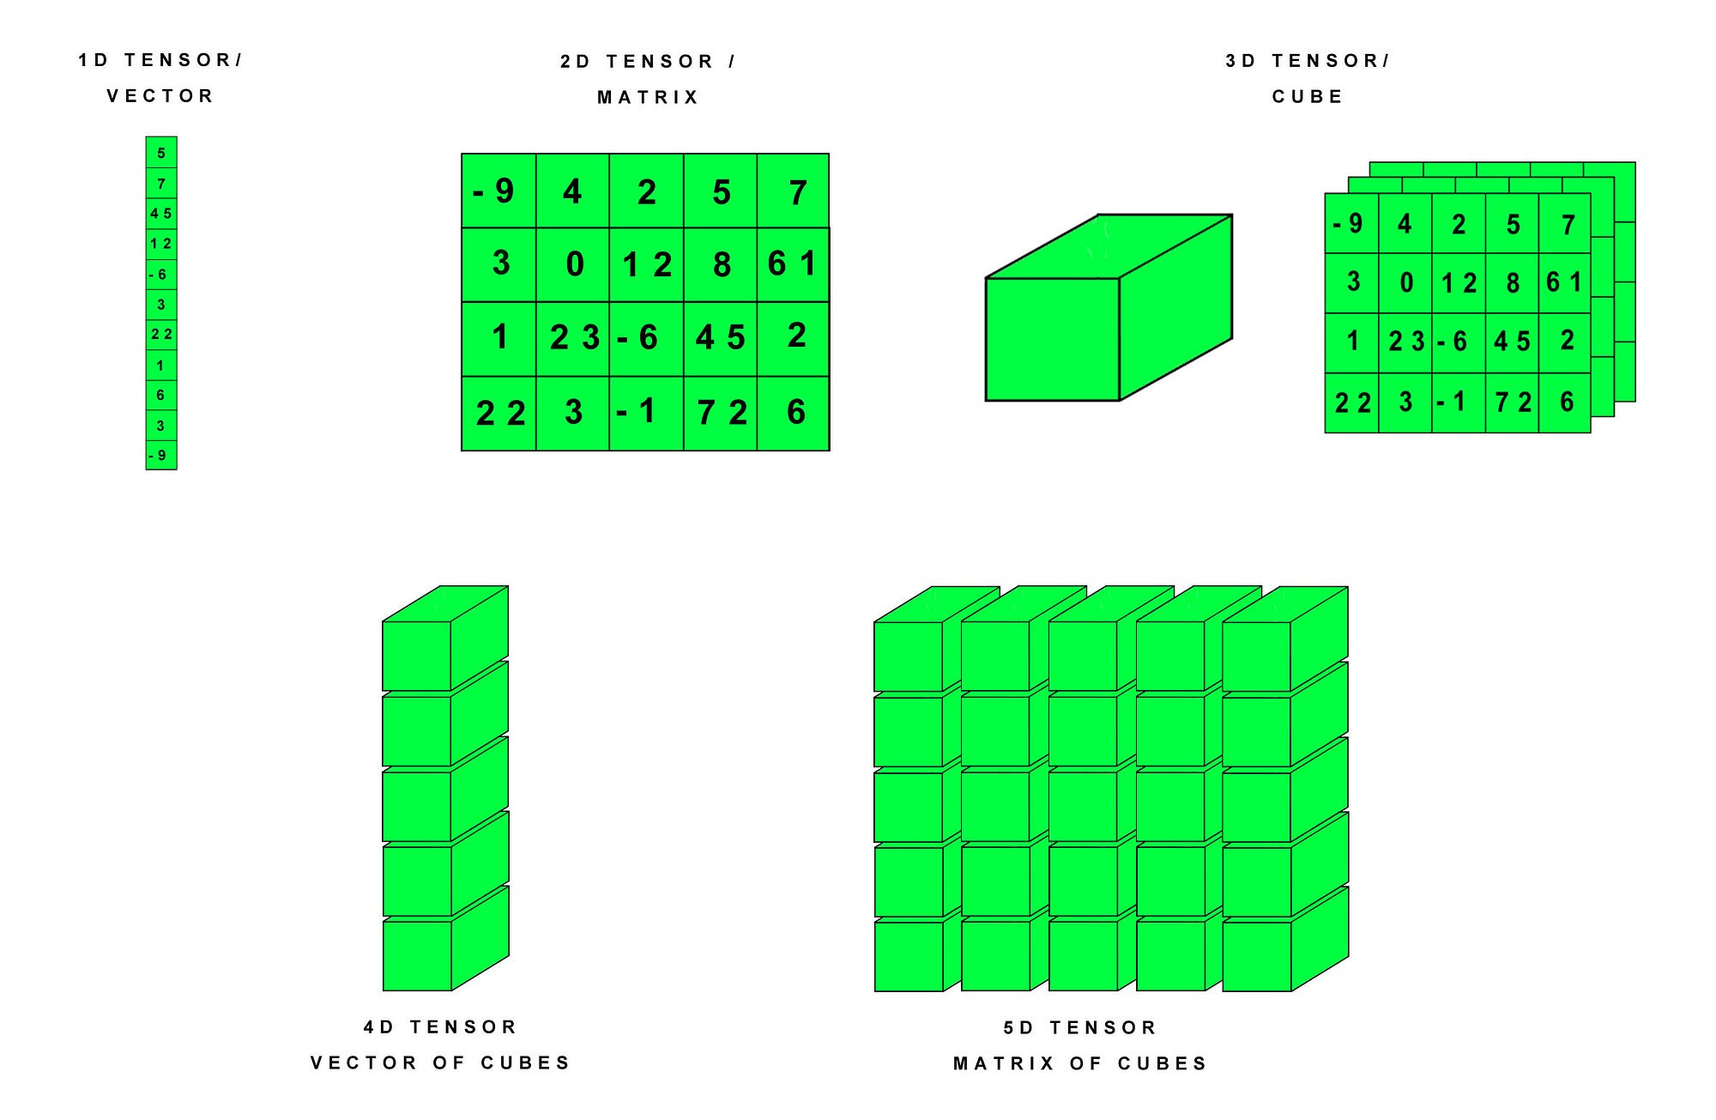
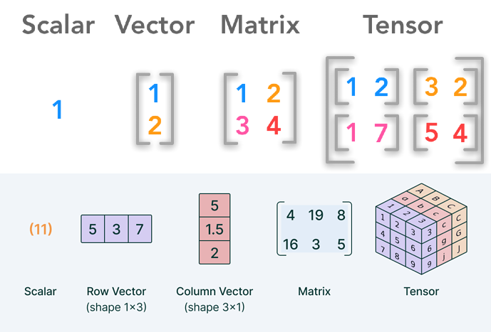
Pytorch and tensors
Tensors are a generic approach to store numbers

Slide 43
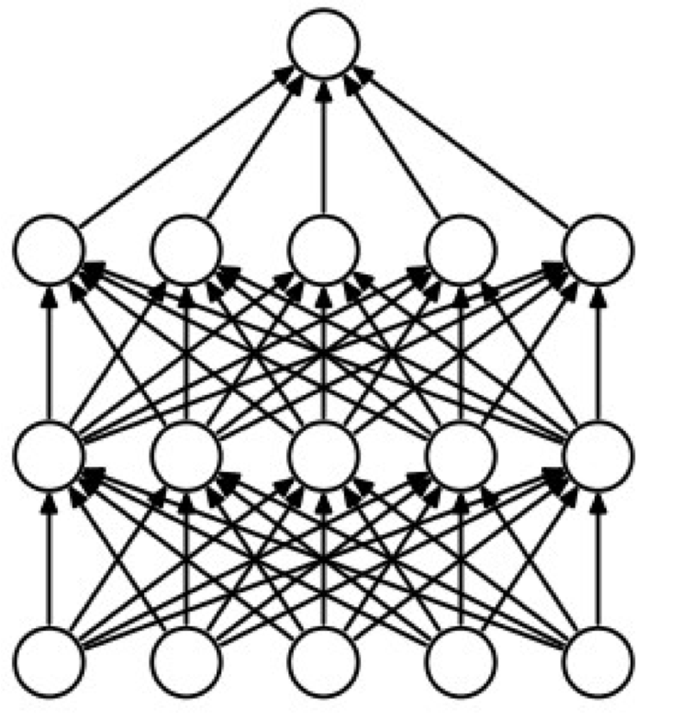
(Deep) neural networks
In neural networks, we “stack” multiple regression models onto each other
The output of the first layer are hidden node activations
Logistic regression
Neural network
output
output
input
input

Slide 44
(Deep) neural networks
Input (X)
Layer 1 (hidden layer)
Linear layer (X . W₁): 20000 → 50 dimensions
Sigmoid layer σ₁(): hidden node activation (A)
Layer 2 (output layer)
Linear layer (A . W₂): 50 → 1 dimensions (logits)
Sigmoid layer σ₂(): class probabilities
Loss calculation
Neural network
output
hidden
input
Implementation in pytorch just as for logistic regression

Slide 45
Session 3: weight optimization

Slide 46
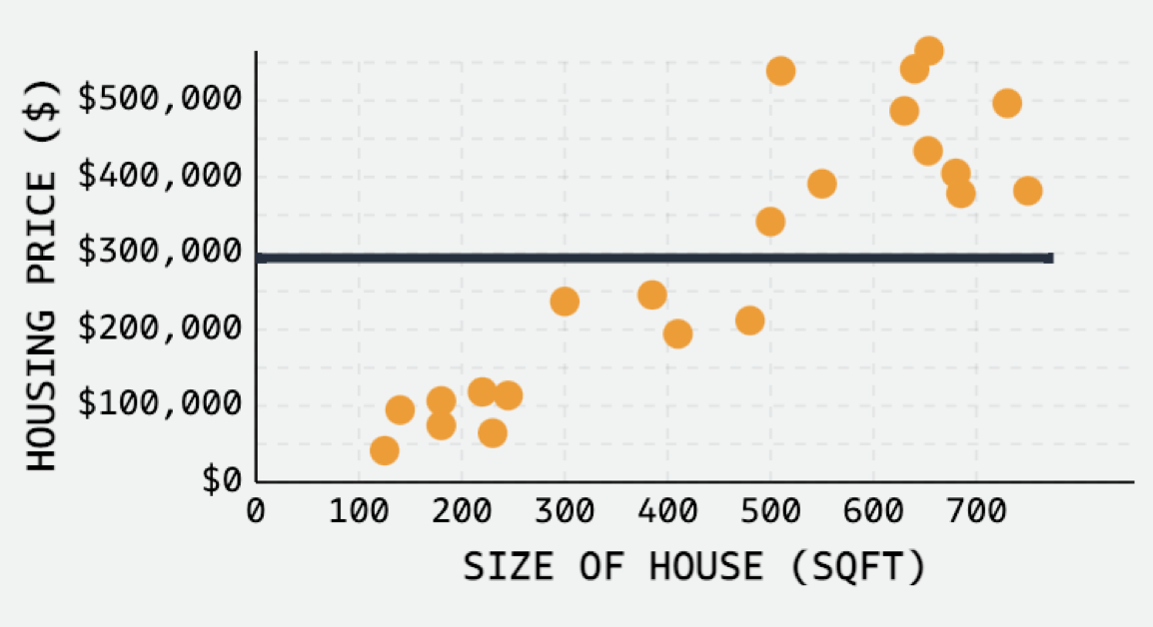
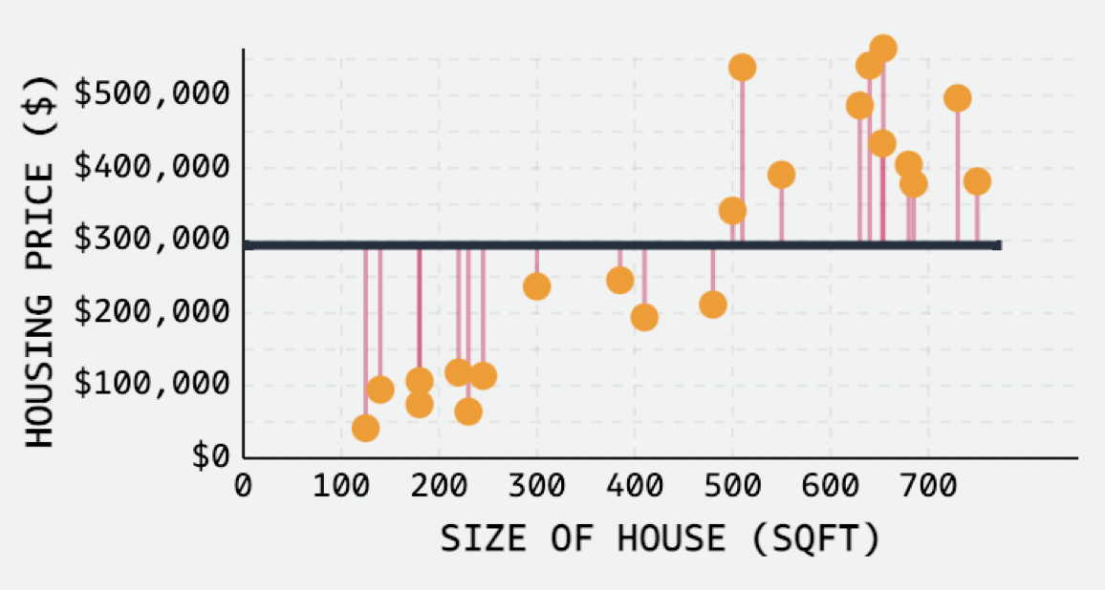

How is a model trained?
How are weights obtained?
In this example:
Start with slope = 0
Measure error
Identify slope that minimizes error

Slide 47
Summary

Slide 48
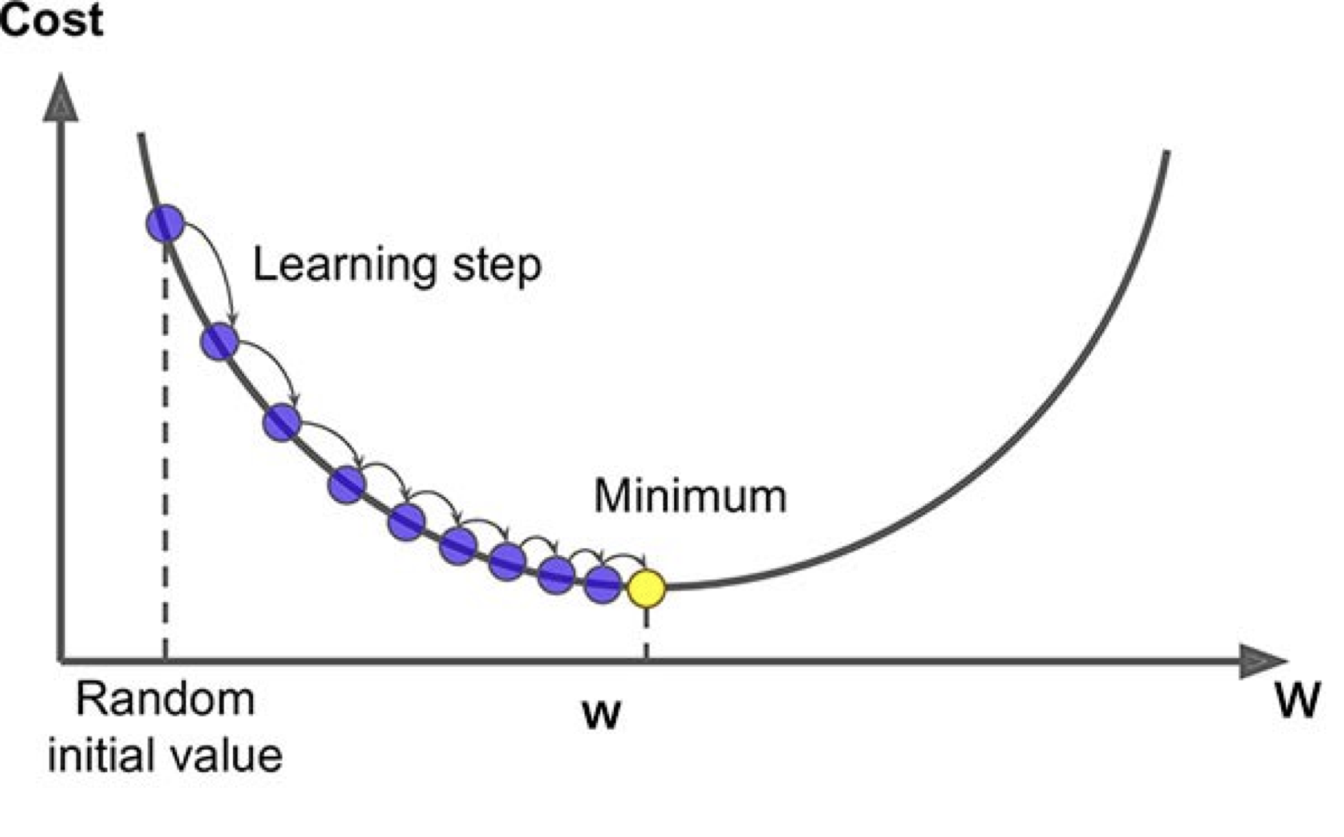
How do we find the right weights in ML?
Use labeled dataset we know the solution!
Generic process:
Start with random weights
Measure cost /loss (error)
Find weights that minimize cost

Slide 49
How do we find the right weights in ML?
Differential calculus?
1st derivative is the slope
THIS IS LEARNING!

Slide 50
Key steps: backpropagation
Input (X)
Linear layer (X . W)
Sigmoid transformation σ()
Loss calculation
Inputs are fixed.
How much would logits change when each weight changes?
How much would class probabilities change when logits change?
How much would the loss change when the class probabilities change?
Forward pass
Backward pass
Requirement: calculations are differentiable

Slide 51
Summary
Weight updates use differential calculus (“gradients”) → how does a change in a weight affect the loss?
Training contains the following steps
Forward pass calculates class probabilities
Backward pass calculates gradients
Weights are updated based on gradients
All of this happens during training (not while testing and prediction)

Slide 52
Practical session 3: multi-class predictions

Slide 53
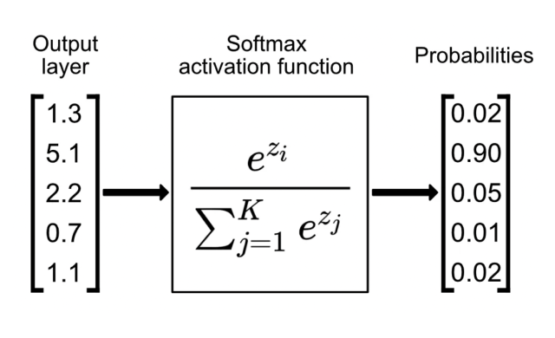
Softmax for multi-class probabilities
Converts real numbers into class probabilities
Probabilities that sum to 1
True labels
 | Cell type 1 | Cell type 2 | Cell type 3 | Cell type 4 | Cell type 5
Cell 1 | 1 | 0 | 0 | 0 | 0
Cell 2 | 1 | 0 | 0 | 0 | 0
Cell 3 | 0 | 1 | 0 | 0 | 0
… | … | … | … | … | …

Slide 54
Session 4: Hyperparameters

Slide 55
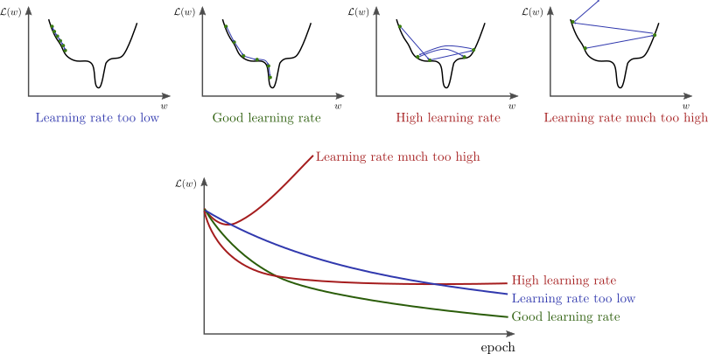
How big are our learning steps?
Loss (cost)
Learning step (epoch)

Slide 56
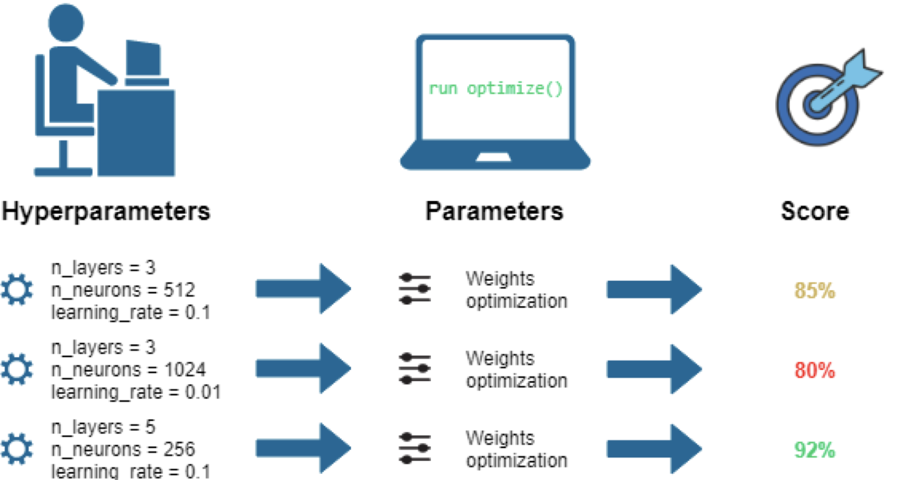
Hyperparameter optimization
in addition to weights (parameters)
other choices are “hyperparameters”
also need optimization

Slide 57
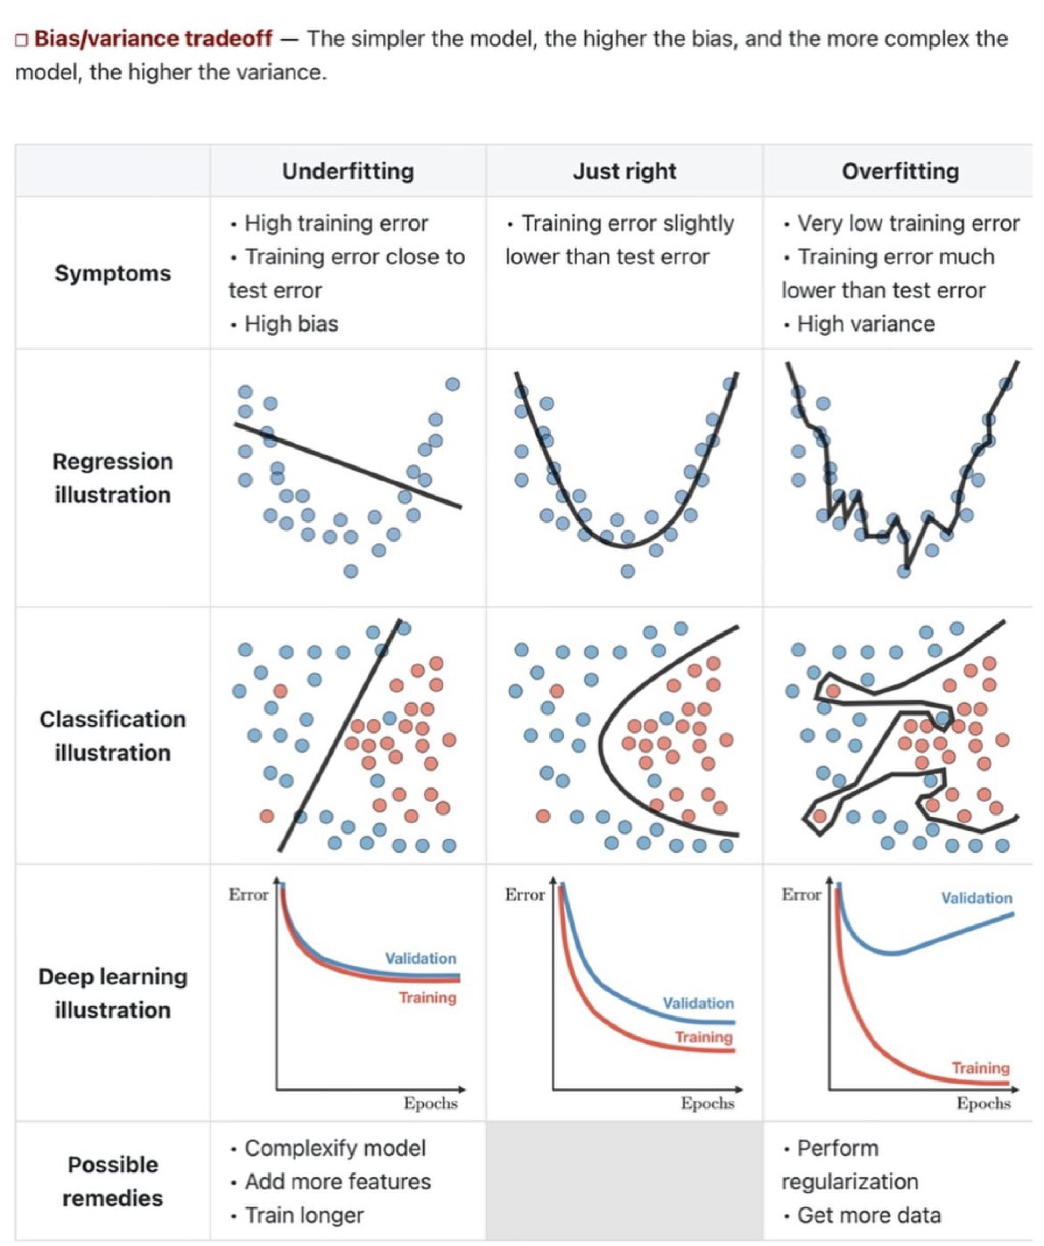
Under- / Overfitting
Underfitting → model is not good enough
Overfitting → model is too good (on training data)

Slide 58
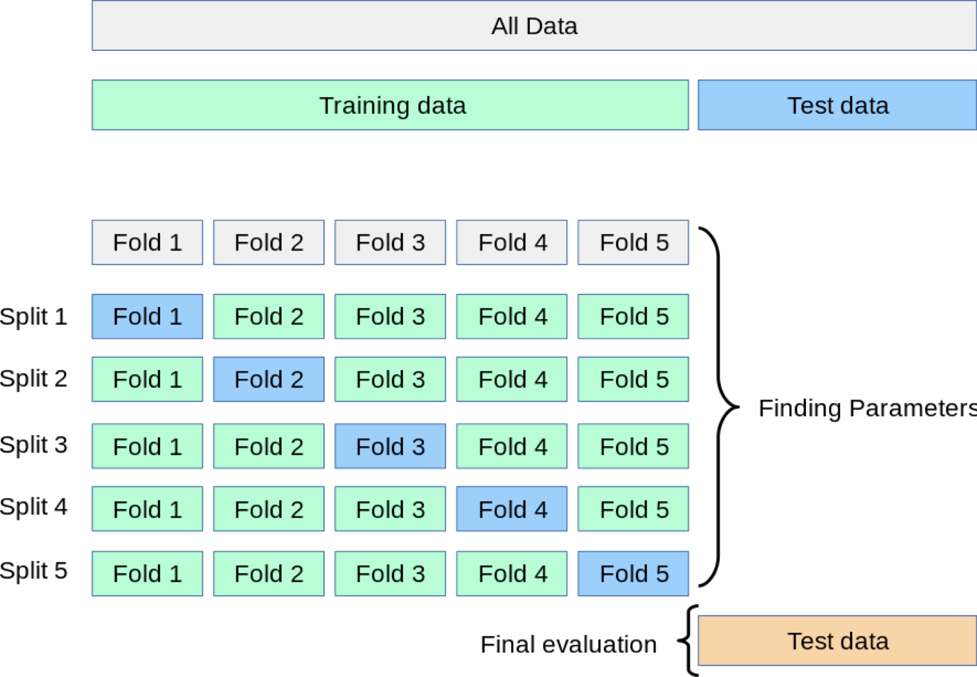
Cross-validation for hyperparameter optimization

Slide 59

Activation functions: another hyperparameter
Non-linear transformations introduce non-linearity
Predictions are not simple additions of features x weights

Slide 60
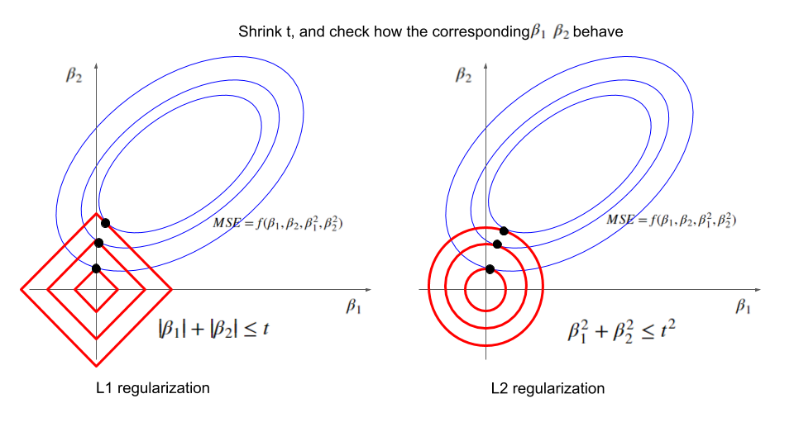
Weight regularization
Commonly used:
l1 loss
l2 loss ("ridge")
Both ("elastic net")
Why?
avoids overfitting
select predictive features
Adds weights to loss:
loss = loss + lambda x sum(f(weights))
The regularization term affects weight optimization!

Slide 61
Session 5: Other models and interpretability

Slide 62
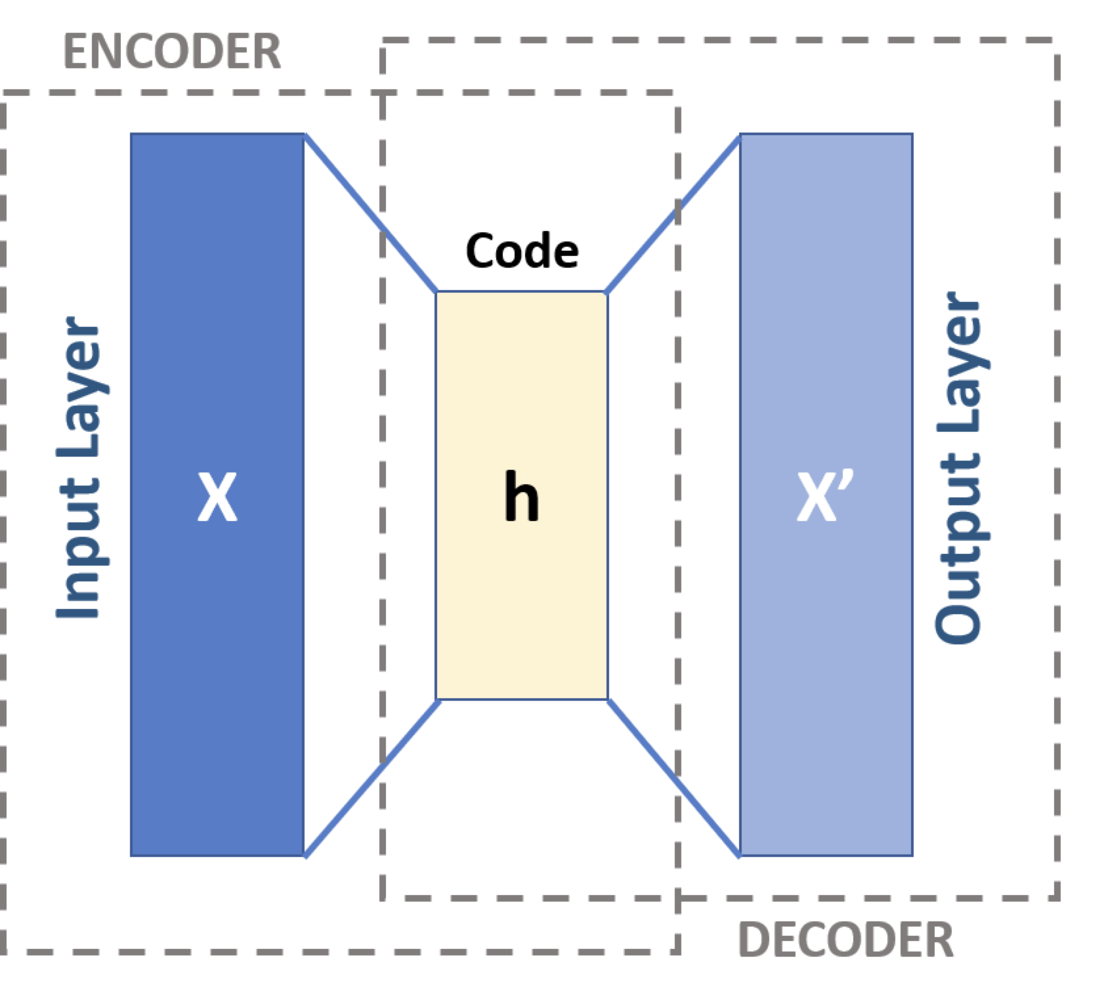
Autoencoders
Model is trained on input to re-produce input as output
Compresses information in a latent dimension
Similarity to dimensionality reduction

Slide 63
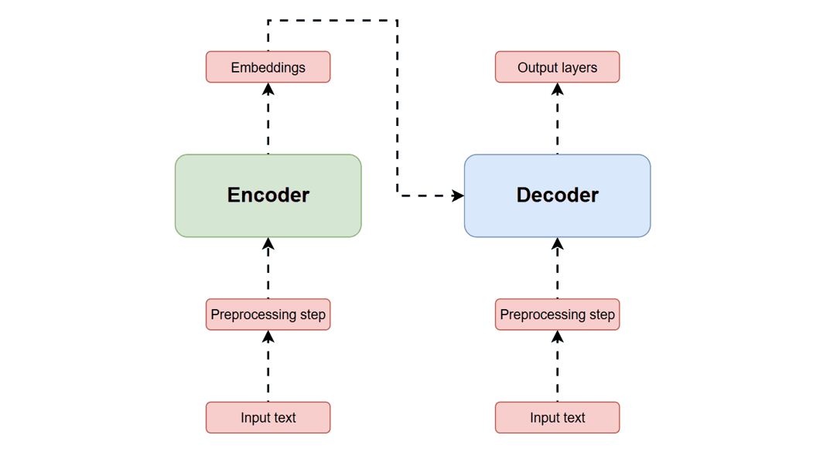
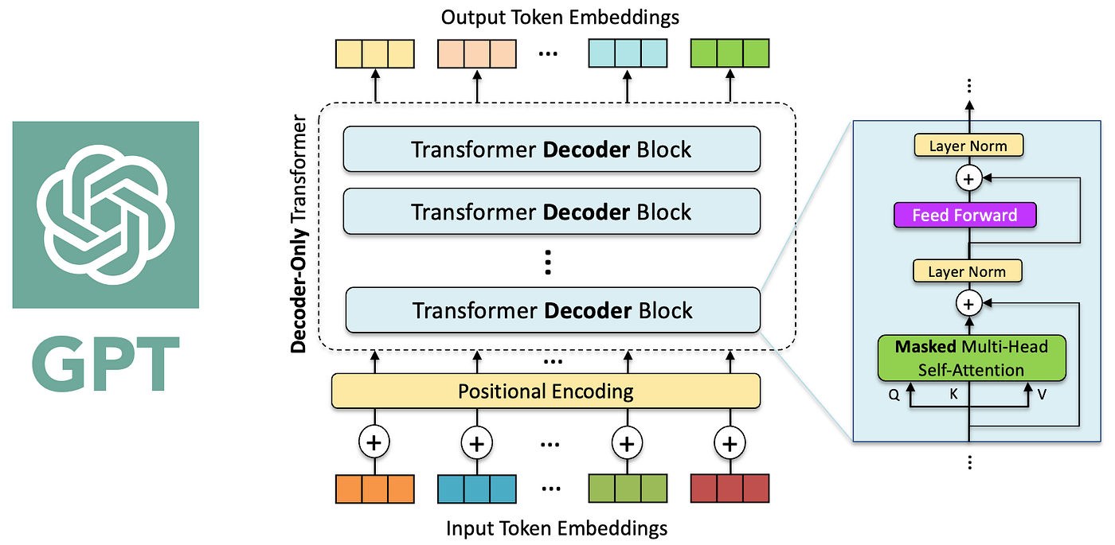
Transformers
https://ig.ft.com/generative-ai/

Slide 64
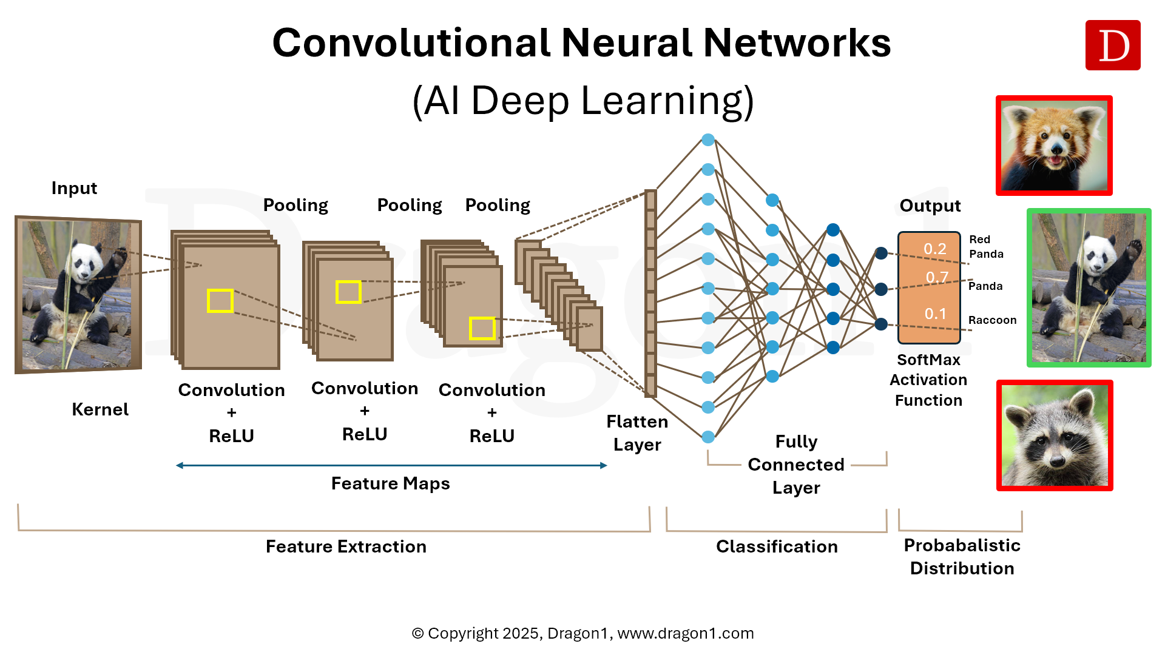
Convolutional neural networks

Slide 65
Non-neural networks

Slide 66
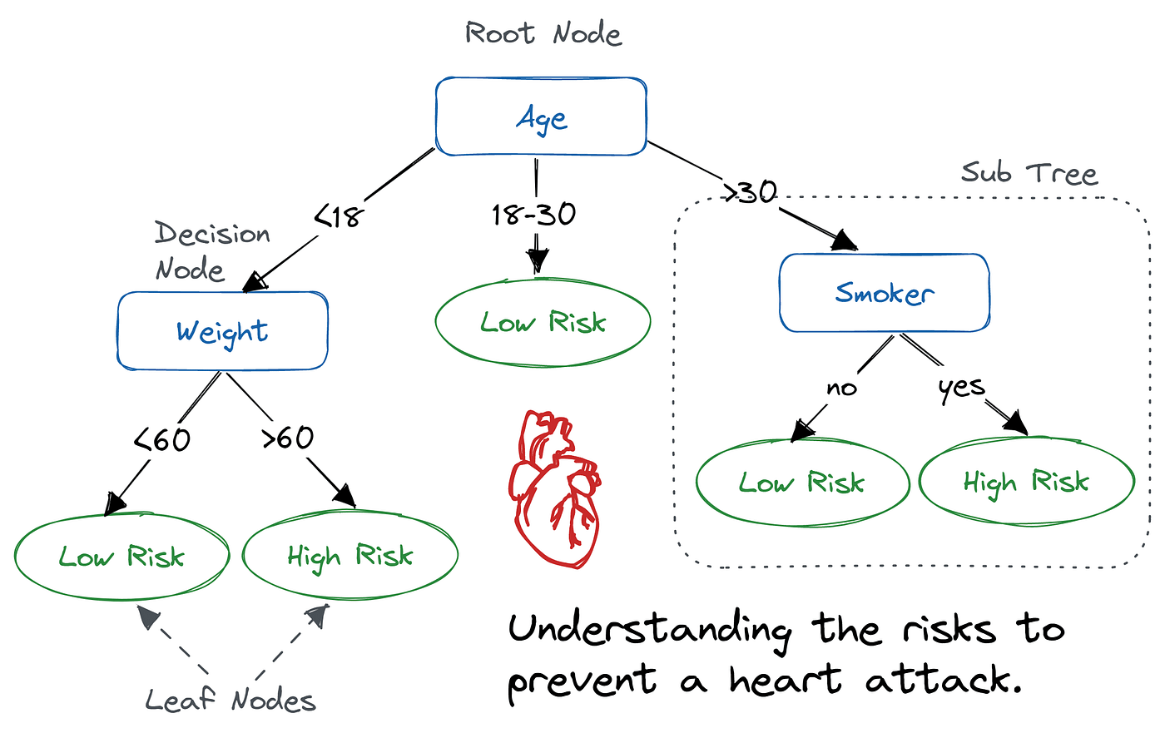
Decision trees
The parameters / weights:
Which variable to test?
Which values?

Slide 67
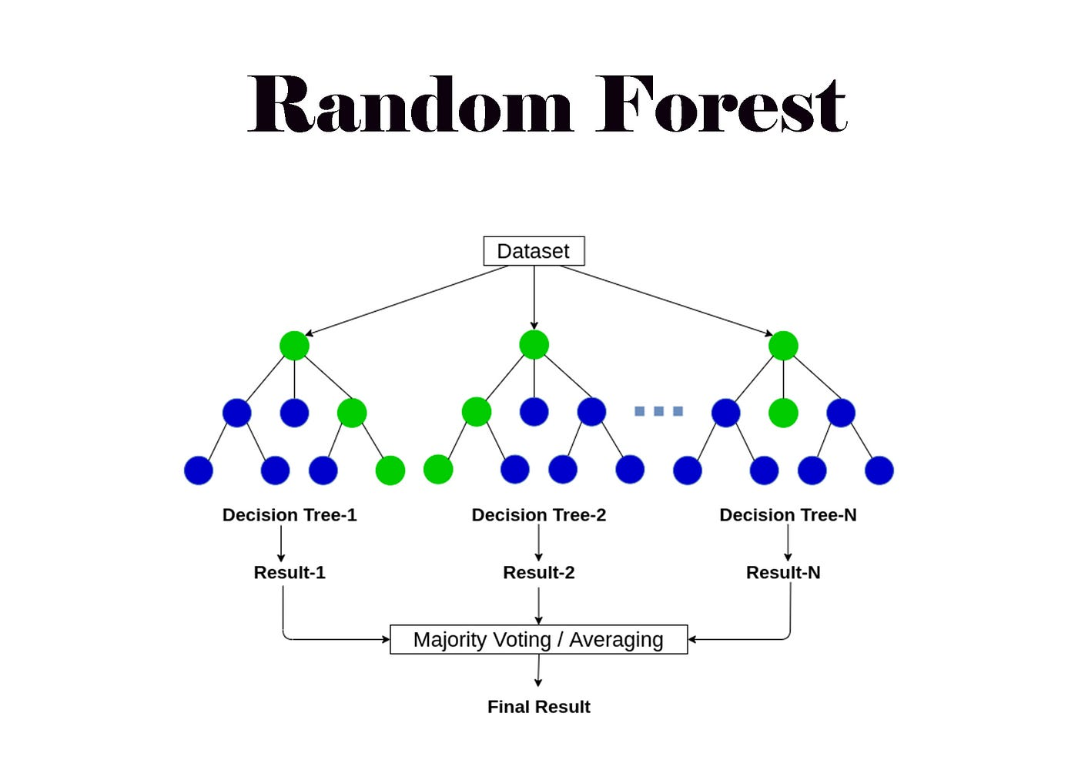
Random forest: ensemble learners
Many trees make one forest!

Slide 68
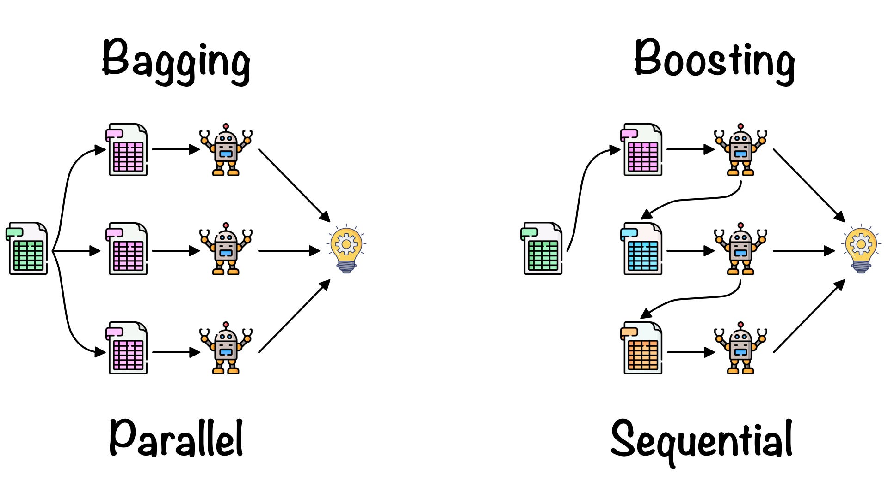
Bagging and boosting
Bagging (many strong learners)
Boosting (many weak predictors): one model trained on errors of other model
Random forest and the related XGBoost models have good performance “out of the box”

Slide 69
What to choose?
Depends on the data
Research: compare different algorithms
Usually standard choices work well:
logistic regression / elastic net
random forest / XGBoost
Neural networks for dedicated applications or complex problems (images, text,…)

Slide 70
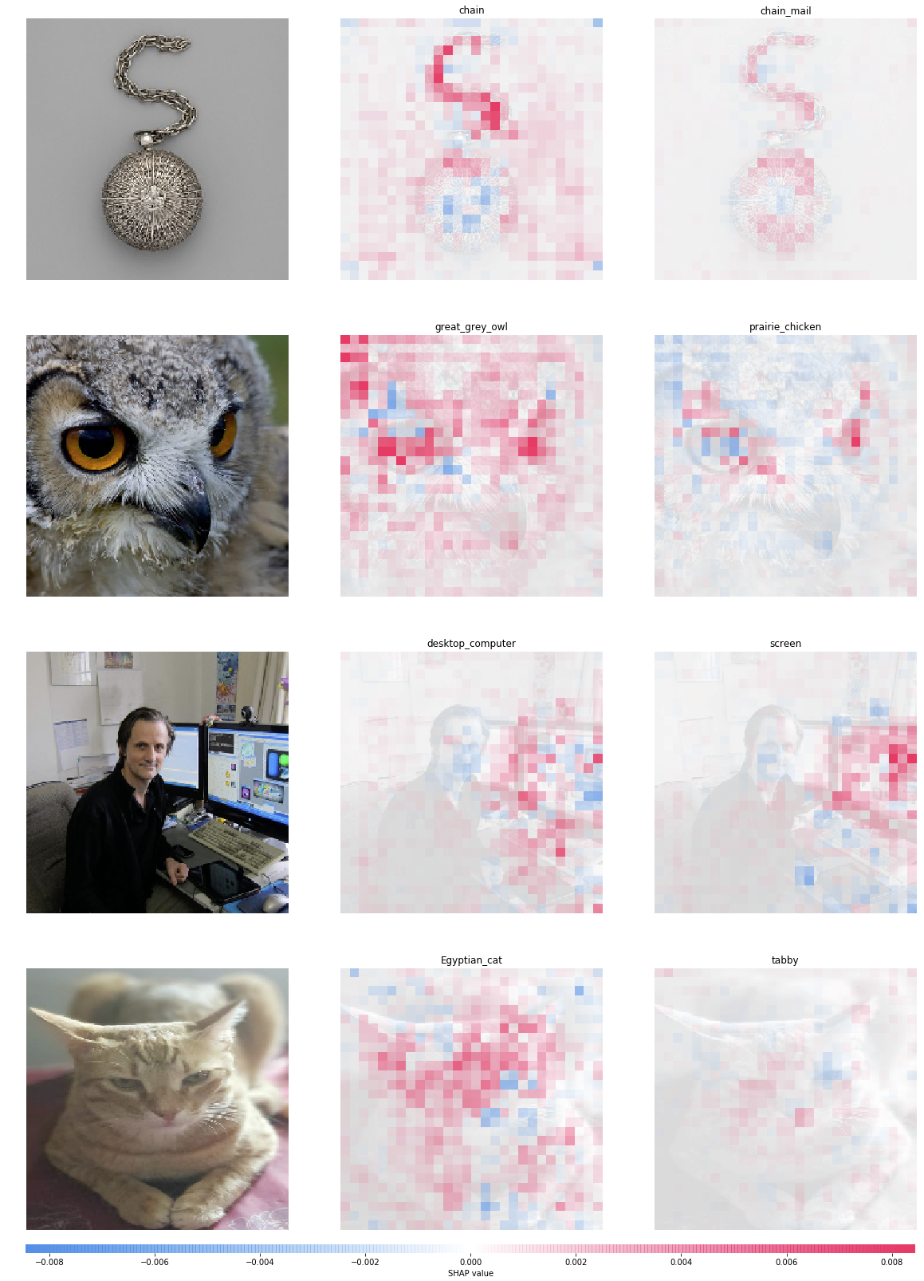
Interpretability
What has the network learned?
Common approach: Which features are important?

Slide 71
Interpretability
Feature permutation: shuffle feature values
Feature perturbation: set features to 0
Big research field:
Feature interactions?
What has the model learned internally?
...
Check one feature at a time
Observations
Features
Labels

Slide 72

Machine learning vs Statistics
Statistical inference is focused on the weights / parameters β
Builds on assumptions that need rigorous testing (normal distribution,…)
If the model fits well, we can interpret the parameters β
We can obtain confidence estimates and p-values for parameters
Machine learning is focused on prediction
Assessed with train/test split (otherwise no assumptions to test)
Weight interpretation is less reliable
Model usually more complex - difficult to interpret the weights

Slide 73
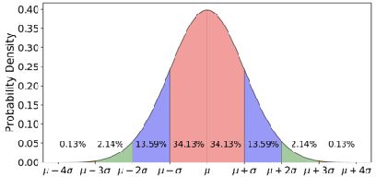
Statistics and machine learning are related and overlapping, but:
Statistical models focus more on inferring something about the population
Machine learning models focus more on predicting new observations
Both models look at the same formula: y = β0 + β1*x1
Statistics: What does β1 tell us about the population?
Machine learning: Which β1 most accurately predicts new y?
We can test this!
Assumptions are less important
More “creative” algorithms
For an interesting read, see: Leo Breiman: Statistical Modeling: The Two Cultures
X
Y
?
X
Y

Slide 75
Final nodes
Goal is understanding
For many approaches (cross-validation, interpretation), dedicated functions / packages exist.
You need to understand what the functions are doing!

Slide 76
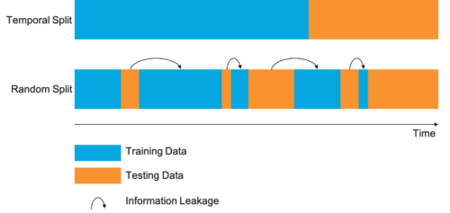
Data leakage
For simplicity, we overlooked some approaches that should be done for 100% proper ML.
Be careful when performance is too good!
E.g.: no preprocessing of the dataset before training:
Preprocessing only in training data
Filter features only in training data (we filtered lowly expressed genes before)
Structure of data not accounted for. For example, multiple samples from the same:
Patient (clinical samples)
Chromosome (protein duplicates)
…
--> Does not test true generalizability!

Slide 77
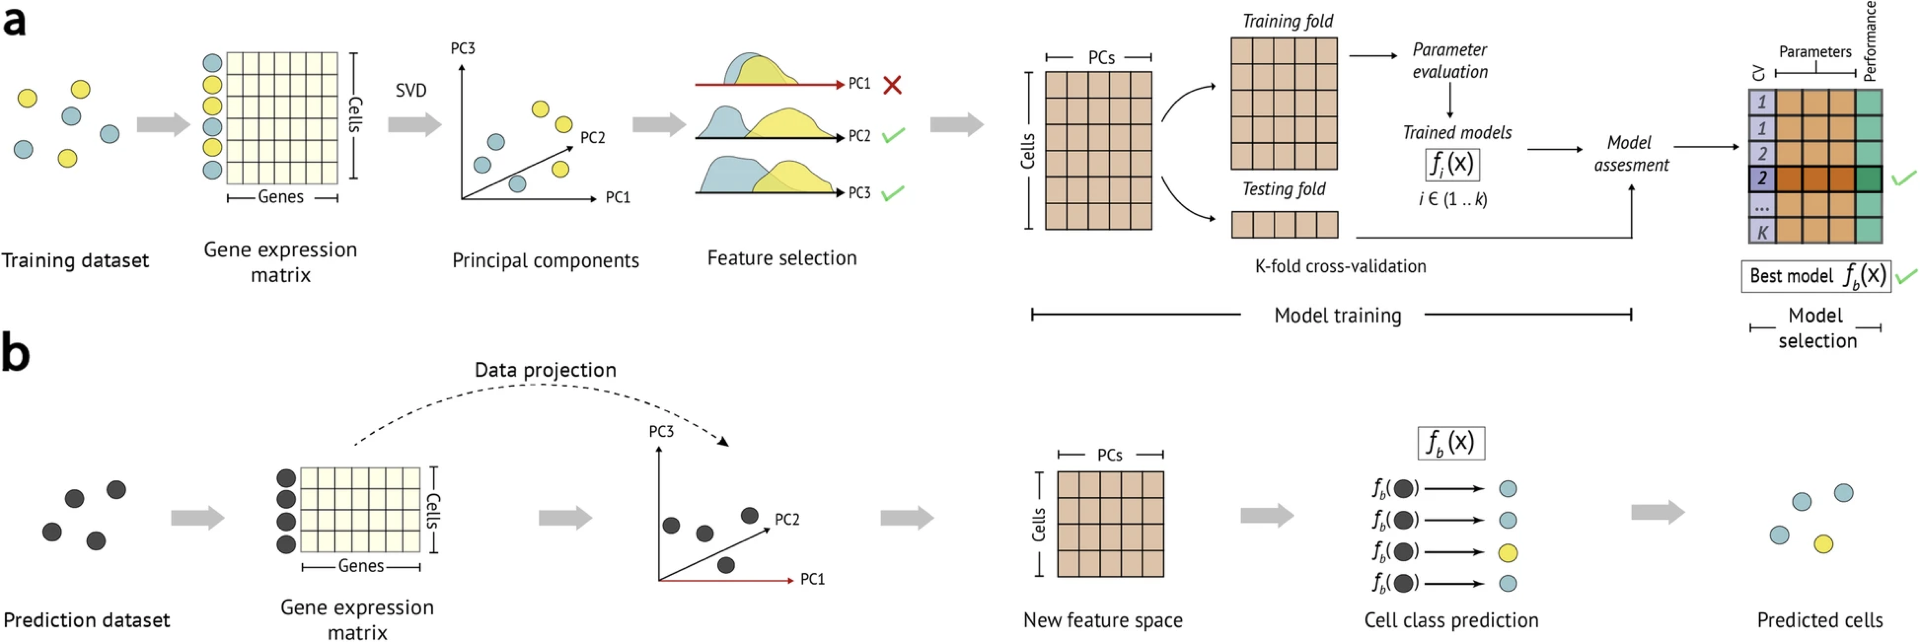

Slide 78
Computational Systems Biology Group
Expertise:
Transcriptome, epigenome, proteome,…
Omics integration
Single-cell and spatial analysis
Networks
Interpretable machine learning
For more details, visit:
https://plus.ac.at/fortelny

